Slide 1
Implementing Semantic Agents with Node-RED
Introduction to and Application Of Node-RED and Semantic Web Technologies

Slide 2
Scope of the Workshop
Node-RED as an exemplary low-code environment & edge-capable runtime environment
“20 years ago, enterprise systems were implemented by 100s of consultants and experts at a multi-million dollar cost, now with no code/low code, the same systems can be implemented by smaller players at a fraction of the price and in a fraction of the time.”
Simon Chan, Founder and CEO, DigiVue Consulting
“While I really appreciate hand coding for very specific things, for a lot of other things it just seems dumb and irrelevant work,”
Jan Bolhuis, IT Regiemanager, Master Software.
“Low-Code/No-Code will disrupt [the] entire pattern [of software development], as enterprises realize they can be even more successful with their digital transformations if they do away with hand-coding altogether, adopting Low-Code/No-Code across their organizations instead.”
Jason Bloomberg, IT industry analyst, Forbes contributor
Notes:
Of course there are also other voices (low-code for large-scale and mission-critical applications? Is it really easier?)
ISSIA 2021 - Embedded Intelligence within the Edge and Fog Computing

Slide 3
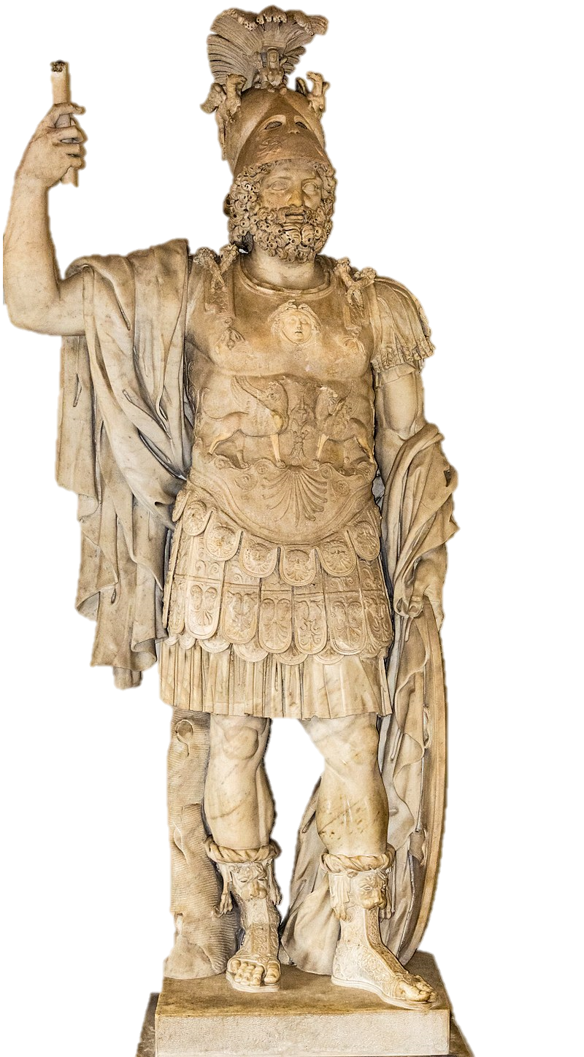


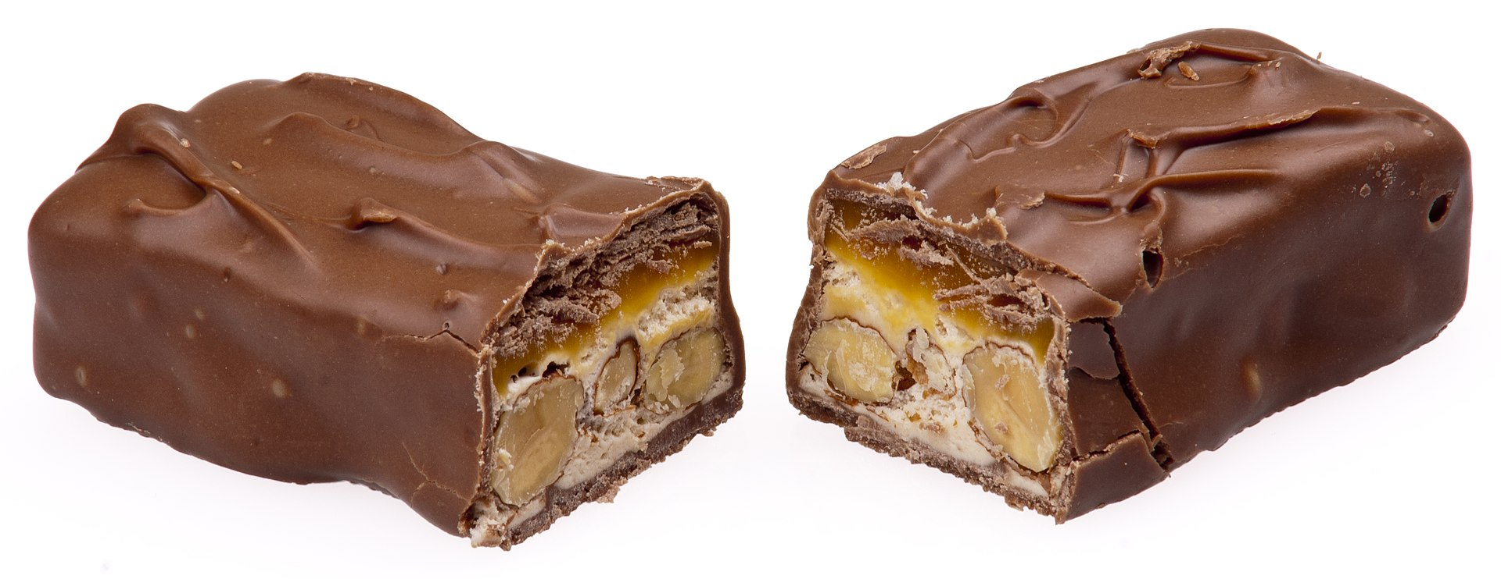
Scope of the Workshop
Introduction to semantic web technologies
"A new form of web content that is meaningful to computers will unleash a revolution of new possibilities“
Tim Berners-Lee
"Mars has been known for a long time.."
?
?
?
The Roman god of war?
The chocolate bar?
The planet?

Slide 4
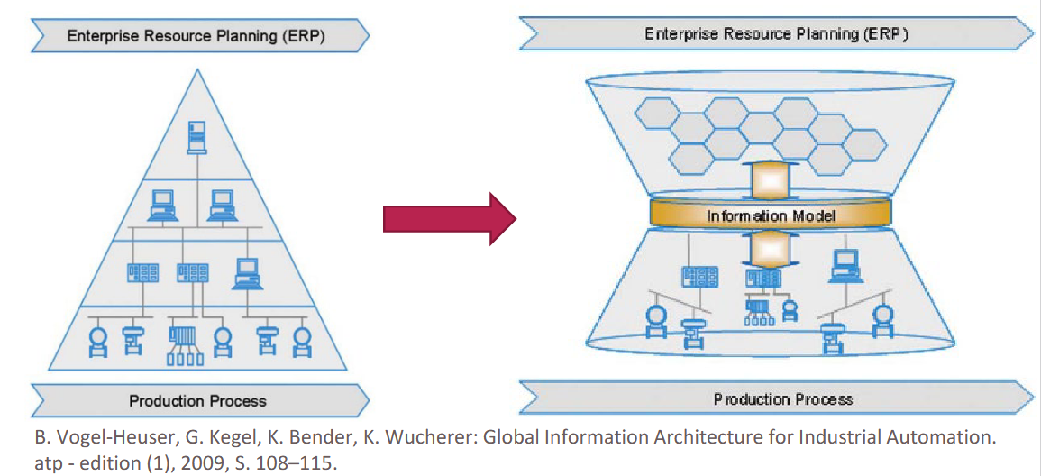
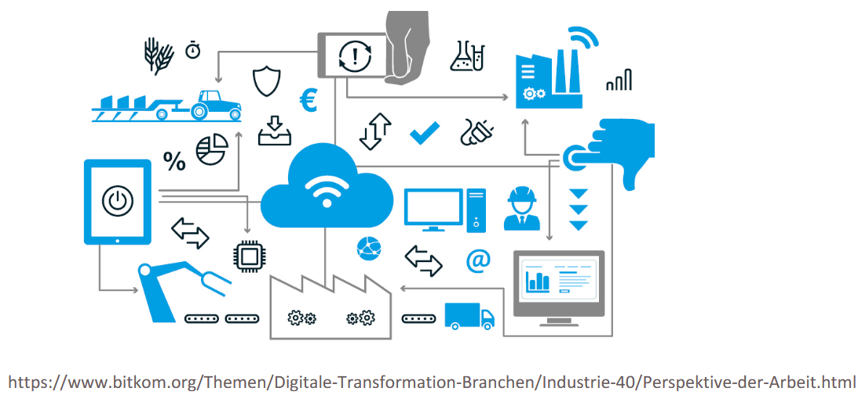
Scope of the Workshop
Introduction to semantic web technologies
The classic automation pyramid provides a hierarchical structure, whose monolithic information technology connection generates many disjoint "data sources"
This is to change within the framework of Industry 4.0 by networking the "data sources". Networking encompasses both the entire life cycle of products, production facilities and orders as well as the connection of all necessary value creation processes“
A. Fay et al.: Durchgängigkeit in Wertschöpfungsketten von Industrie 4.0. In: VDI (Hrsg.): AUTOMATION, 2016.
Notes:
e.g. Sensor information from machines not linked with production strategies in the MES, MES order information not digitally available on machines...

Slide 5
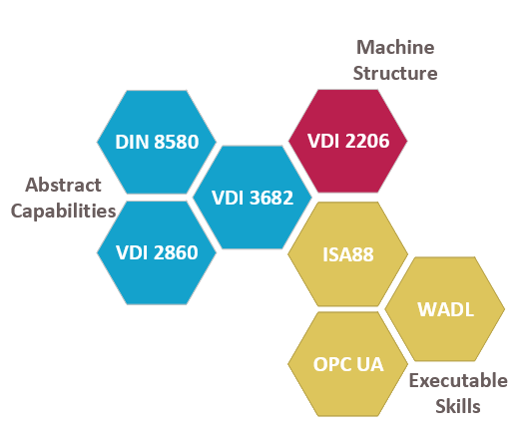
Scope of the Workshop
Capability and Skill-based Engineering
Plug & Produce
Formal description of machine functions
Adaptation
Unifying model over different execution technologies
Production Planning
Köcher, Aljosha, et al. "A formal capability and skill model for use in plug and produce scenarios." 2020 25th IEEE ETFA. Vol. 1. IEEE, 2020
Reconfiguration

Slide 6
Agenda
Introduction & Scenario Description
Implementation Part 1 (Basics + HTTP)
Ontologies, SPARQL & Capabilites
Implementation Part 2 (Products and Agent Registration)
Thoughts on Negotiations & Semantics for Agents
Implementation Part 3 (Message Processing)
Implementation Part 4 (Bid Selection)
Session 1
Coffee Break
Session 2

Slide 7

Disclaimer
We have designed this workshop as a crash course that you can follow along
BUT there are quite a lot of requirements:
Agent basics
Node-RED basics + Node-RED installed
JavaScript basics
Semantic web basics + GraphDB installed
In case you find yourself "crashed":
Feel free to ask questions
You can find everything on Github: https://github.com/hsu-aut/ISSIA22-node-red-agents
Checkout individual aspects again later
https://twitter.com/carsparkedwrong

Slide 8
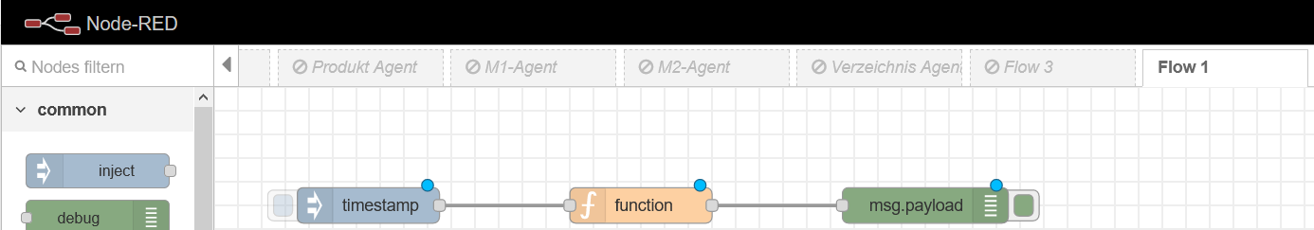
Node-RED
Start Node-RED via Command line (> node-red) and open http://localhost:1880 in your browser
Flow basics
Message-based
Nodes: Inject, function, delay
Deploy
Debugging: Node.warn() or debug messages

Slide 9
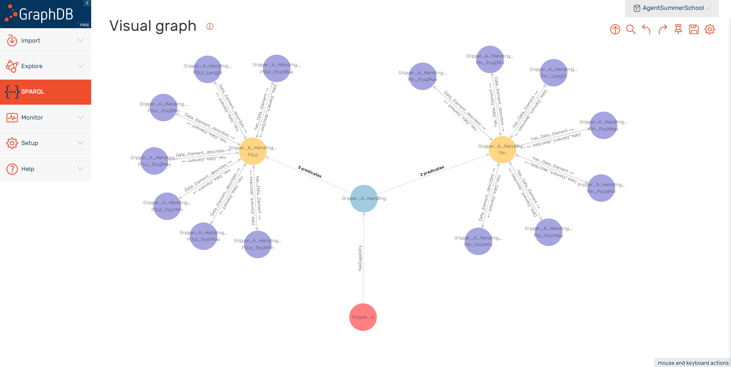
GraphDB

Slide 10

Scenario Description
Distributed Control Architecture → Reconfigurable and Robust
Workpiece presence is registered by sensor and ID is detected
Presence not detected anymore
1
2
Gripper 1
A
B
Conveyor
Conveyor
Gripper 2
Light barrier
Light barrier
Workpiece
Workpiece
Notes:
Werkstücke (identifizierbar mit z.B. Barcode) werden auf einem Förderband (Conveyor) transportiert.
Das Förderband sowie die Sensoren und Greifer (Gripper) sind durch Agenten repräsentiert.

Slide 11
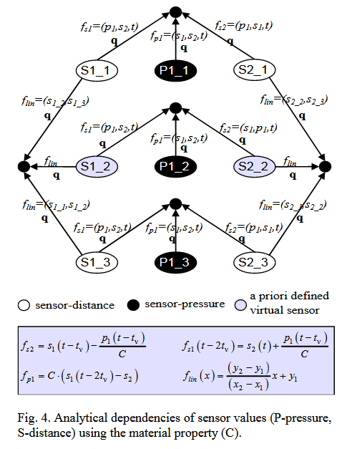
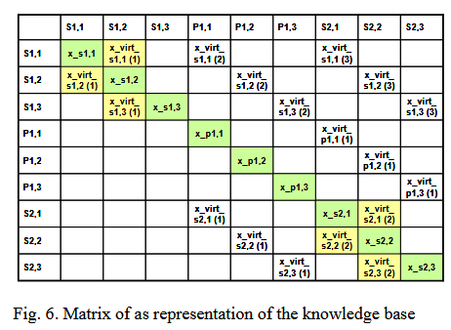
Scenario Description
Short Digression
A asks Conveyor what distance was covered during detection time → Save id & length in GraphDB
3
Gripper 1
A
B
Conveyor
Gripper 2
Light barrier
Workpiece
A. Wannagat, B. Vogel-Heuser: Increasing Flexibility and Availability of Manufacturing Systems - Dynamic Reconfiguration of Automation Software at Runtime on Sensor Faults, IFAC Proceedings,Volume 41, Issue 3, 2008, pp. 278-283,

Slide 12
Scenario Description
A asks Conveyor what distance was covered during detection time → Save id & length in GraphDB
B detects ID and asks for length from GraphDB
3
4
Gripper 1
Gripper 1
A
B
Conveyor
Conveyor
Gripper 2
Gripper 2
Light barrier
Light barrier
Workpiece
Workpiece

Slide 13
Scenario Description
5
B requests stop from Conveyor at the correct position (e.g. center of the workpiece)
B selects appropriate Gripper, workpiece is picked up by Gripper
6
Gripper 1
Gripper 1
A
B
Conveyor
Conveyor
Gripper 2
Gripper 2
Light barrier
Stop position
Light barrier
Stop position
Workpiece
Workpiece

Slide 14
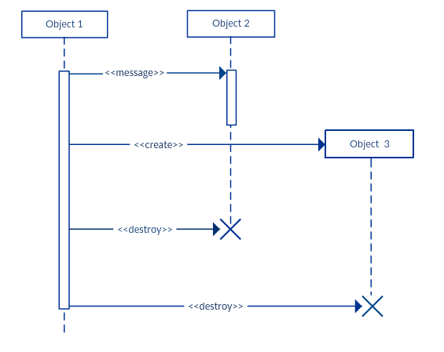
UML - Sequence Diagrams
Basics
Objects / Agents
Life line
Synchronous messages / method calls
Control focus
Time
Answer
Source: http://creately.com/blog/diagrams/sequence-diagram-tutorial/
Notes:
Ein Sequenzdiagramm (englisch sequence diagram) ist ein Verhaltensdiagramm, welches eine Interaktion im Sinne der Unified Modeling Language (UML) grafisch darstellt.

Slide 15
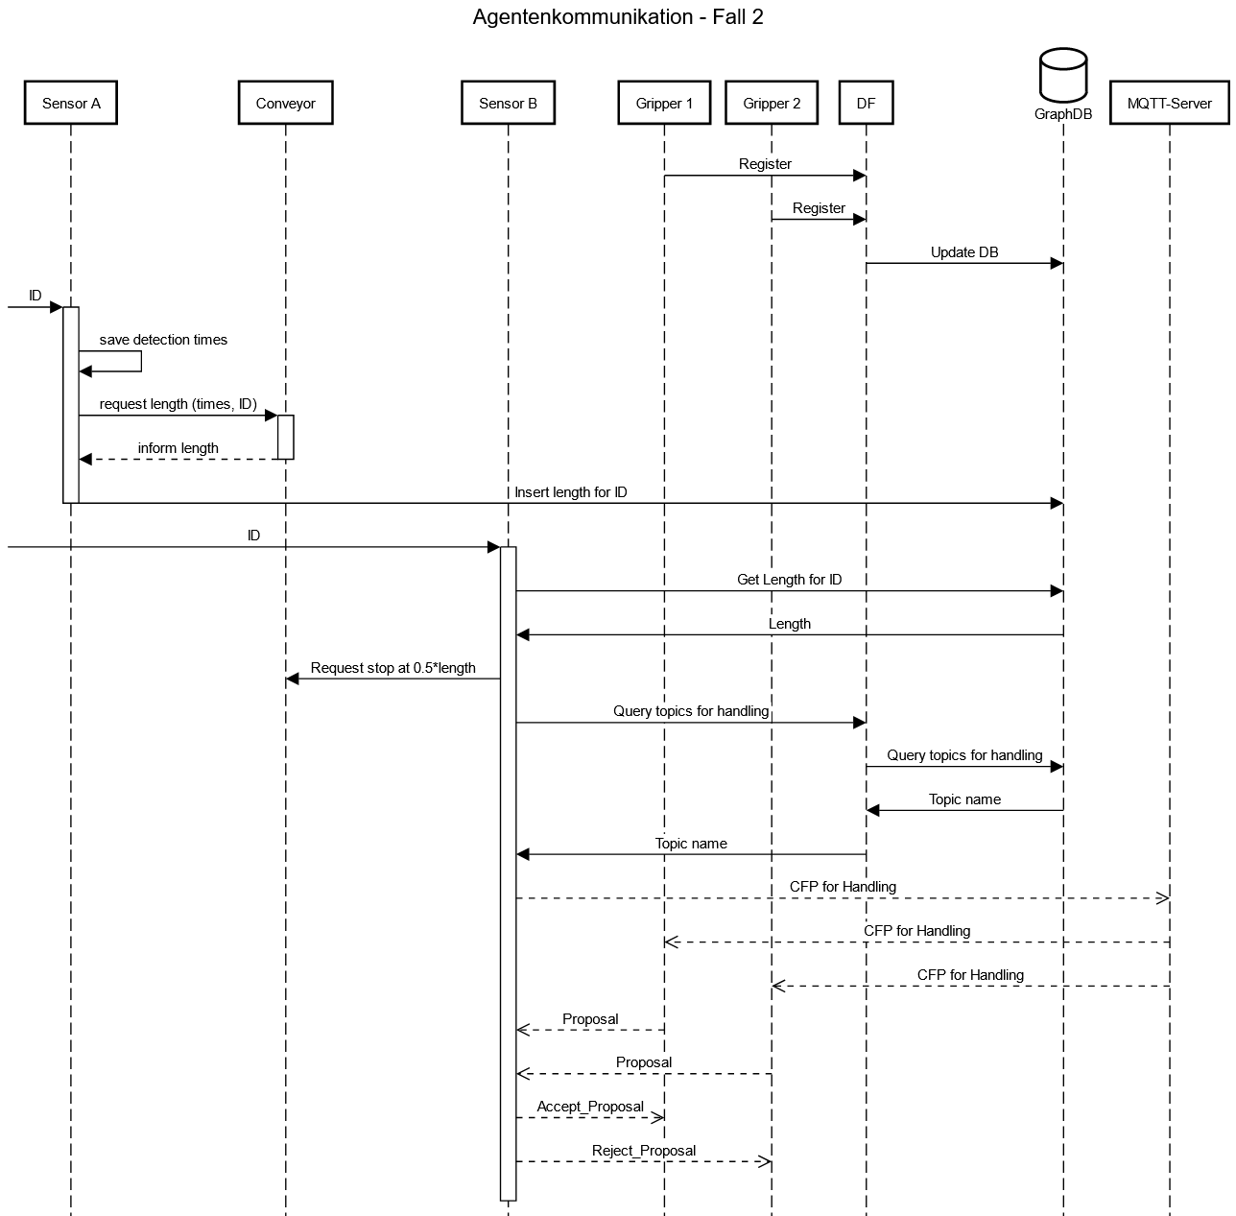
Overview Session 1
Part 2
ID (Barcode) of workpiece is recognized. Delay = time of detection
Part 1
Conveyor-Agent knows speed of and controls conveyor. Using the time instances the conveyor agent can calculate the distance covered

Slide 16
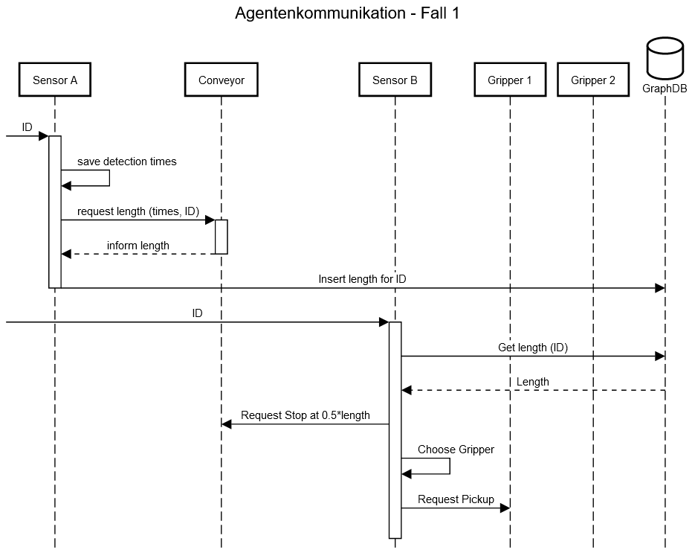
Part 1 – Sensor A
Import the template flow for agent "Sensor A"
An Inject node needs to generate a message with…
… an empty JSON object ( {} ) as its msg.payload
… a msg.delay of "500 + $random() * 500" (as an expression)
This delay is used to simulate the time it takes the workpiece to pass through Sensor A
Connect your Inject node with the given node "generate random ID and time"
Notes:
Delay = Länge des Werkstücks (Anwesenheitszeit in Lichtschranke) → Ergibt 0,5 bis 1 m Paketmaß

Slide 17
Part 1 – Sensor A
A Delay node (between "generate random ID and time" and "time_difference") is going to simulate the workpiece passing through the sensor
Add a Delay node
This node needs to use our randomly generated msg.delay (is defined in the inject node)
Implement the function "time_difference"
In this function, define a variable "sensorA_timeEndDetection" which adds the delay to the initial detection time ("sensorA_timeStartDetection")
Make sure to store your variable inside msg.payload
Check the current msg.payload with a Debug node behind "time_difference"
Notes:
Ablage barcode, payload ähnlich wie Hashmap

Slide 18
Part 1 – Communication between Sensor A and conveyor
Let's take a look at the node to get workpiece lengths from the conveyor…
Communication via HTTP
Notes:
Wechsel zu Aljosha

Slide 19
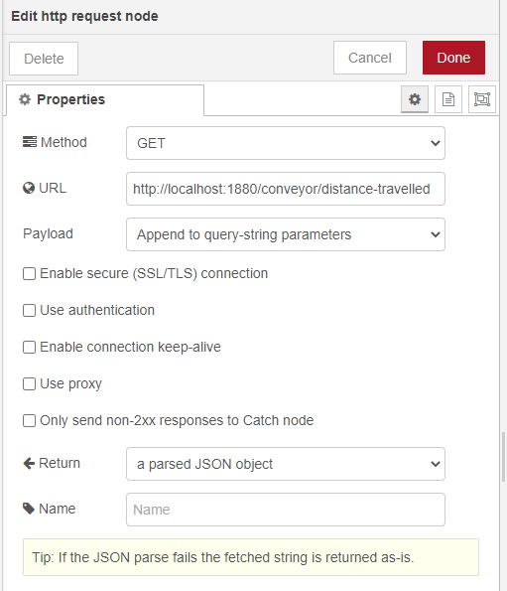
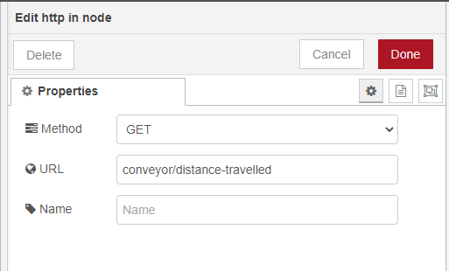
Part 1 – HTTP communication
HTTP-Nodes
http-request: To request a web service
HTTP Method and URL (here "localhost" + port + "service name") required
URL may be set dynamically: msg.url = "http://localhost:1880/" + someVariable;
http-in: To provide a web service
Method and URL (more precise: path relative to "localhost:1880") required
Important: A http-response node is required to send a response and end the request

Slide 20
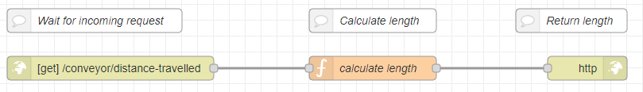
Part 1 – Communication between Sensor A and conveyor
Next steps:
How can we calculate the workpiece length?
Which information is required?
Import the conveyor agent flow and extend it by implementing the function "caluclate length via timestamps"
Provided HTTP endpoint at which a service is available
HTTP request triggers this function. We will insert our logic here
Return calculated information
Notes:
-
Jetzt Conveyor, 2 m/s
5 Minuten + besprechen

Slide 21

Part 1 – How we could continue…
Continue as before:
Implement functionality of Sensor B and "hard-wire" it to Sensor A (B requests length from A)
Add two gripper flows + a simple selection rule in Sensor B to determine a matching gripper
Downsides of this approach
Error-prone:
Everything hard-coded, errors are hard to find
No explicit agent / capability description
Inflexible
No chance to react on breakdowns etc.
Not possible to add / remove agents in some kind of "registry"
Next steps: Using an ontology
Functions to dynamically register / unregister agents
Using an ontology as a shared "language" between agents
Using explicit rules to find agents
Gripper 1
A
B
Conveyor
Gripper 2
Gripper 1
A
B
Conveyor
Gripper 2
Worker
A
A2
Conveyor 1
Conveyor 2

Slide 22
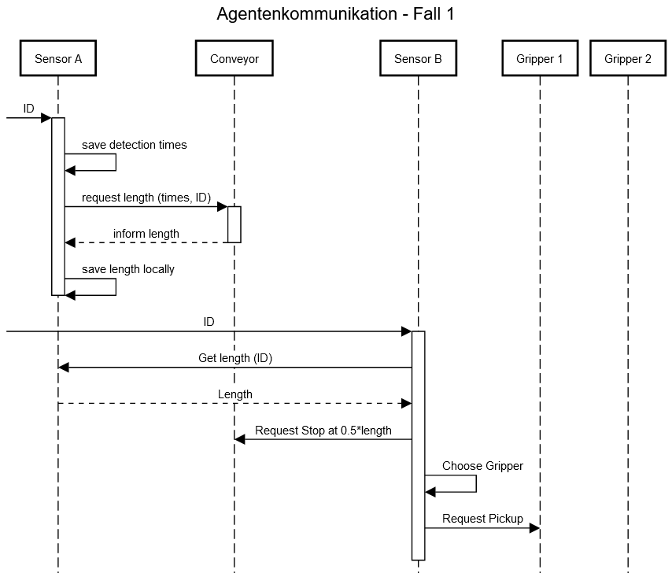
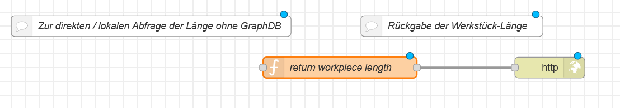
Part 1 – Sensor B
Import the flow of Sensor B agent
Sensor B needs to get a workpiece's length, which only Sensor A knows
In the flow of Sensor A, add an "http-in" node in front of "return workpiece length" and give it the URL "/sensorA/get-length"
Add an "http-request" node to Sensor B that gets the workpiece length from Sensor A by requesting the URL above
Make sure to select Return = "A parsed JSON object" to get the msg.payload as a proper object and not as a string
Notes:
Wechsel zu Felix
Msg.url = Input für den HTTP-Request

Slide 23
Part 1 – Sensor B
Add a simple rule to the function „select gripper“ in Sensor B which selects the gripper to be used:
wp_length > 0.75 → Gripper_A
wp_length <= 0.75 → Gripper_B
Syntax for if-conditions:
if (x > 1) { variable = <value>; } else { variable = <anotherValue>; }
Dynamically compose a URL in order to contact the selected gripper:
Base: http://localhost:1880/X
(X = <Gripper name>/handling)
Notes:
Msg.url = Input für den HTTP-Request

Slide 24
Part 1 – Grippers & Testing
Import the gripper flows
Add "debug" nodes to track information within the flow
Start the scenario:
Click "inject" in Sensor A (= a workpiece arrives at A)
Click "inject" in Sensor B (workpiece arrives at B)

Slide 25
Preparation for Part 2: An Introduction to Semantic Web Technologies

Slide 26
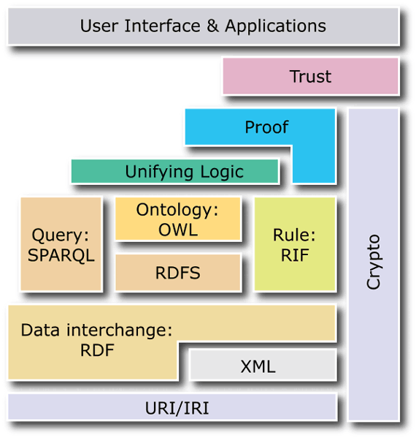
The Semantic Web – A technology stack
More advanced W3C Standards:
“Semantic Web Rule Language” (SWRL) is a language to define rules that go beyond OWL's rule functionalities
“Shapes Constraint Language” (SHACL) to define constraints that have to be satisfied by an RDF graph
W3C standards of the Semantic Web:
“SPARQL Protocol And RDF Query Language” (SPARQL) is the semantic web's query language used to retrieve information
“Web Ontology Language” (OWL) is used to model complex ontologies with advanced expressions about terms and their relations
“RDF Schema” (RDFS) adds ways to model a schema on top of RDF graphs which allows to define classes and class hierarchies
“Resource Description Framework” (RDF) is a basic technology of the semantic web used to represent simple facts about resources and relations as a graph
Fundamental standards:
“Extensible Markup Language” (XML) is a markup language to model hierarchically structured Data using tags
Uniform Resource Identifiers or Internationalized Resource Identifiers are used for IDs that uniquely define elements
SPARQL: Queries
OWL: Advanced Models
SWRL: Advanced Rules
RDFS: Simple Models
RDF: Represent simple facts as a graph
XML:Document structure
URI/IRI: Identifiers for elements

Slide 27
Ontology Example
Ontologies can be visualized as directed graphs:
Resources (e.g. Agents, Capabilities, Products) are nodes
Directed edges between nodes depict object properties – i.e. the relations - between resources (e.g. hasCapability)
Primitive data values (strings, numbers, …) are modeled using data properties (e.g. hasValue, hasDescription)
Resources and object properties have unique IDs (URI / IRI) → Prefixes allow to shorten these IDs
Stored using various formats, e.g. Turtle Syntax:
"Agent1's capability to handle a product"
http://hsu-hh.de#hasDescription
http://hsu-hh.de#Agent1_Handling
agent:Agent1 agent:hasCapability agent:Agent1_Handling
<Subject> <Predicate> <Object>
http://hsu-hh.de#hasCapability
rdf:type
http://hsu-hh.de#Agent1
http://hsu-hh.de#Capability
rdf:type
owl:disjointWith
http://hsu-hh.de#Agent
owl:disjointWith
rdf:type
rdf:type
owl:class

Slide 28












Ontology Development
… is time-consuming and complicated if done right
There is a whole research area around the question "How to develop ontologies?"
.owl
Project requirements
Ontology Requirements Specification
Document
Heavyweight Ontology
Ontology Requirements Specification
Lightweight Ontology Building
Heavyweight Ontology Building
Method based on [Hil18a] and [Hil18b]
Information Resources
Lightweight Ontology
.owl
Ontology Design Patterns
To get good ontologies with manageable effort, reuse is important
One essential way to increase reuse: Create ontologies based on standards
Standards typically contain general knowledge widely applicable to a range of projects
Standards are typically agreed upon by a large community
[Hil18a] Hildebrandt, Constantin et al. (2018): Ontology Engineering for Collaborative Embedded Systems – Requirements and Initial Approach. In: Ina Schäfer und Dimitris Karagiannis (Hg.): Fachtagung Modellierung 2018.
[Hil18b] Hildebrandt, Constantin et al. (2018): Ontology Building for Cyber-Physical Systems: A domain expertcentric approach. In: 2018 14th IEEE CASE. Munich, Germany, 20-24.08.2018.

Slide 29
VDI 3682 in detail
VDI 3682 – Formalized Process Description
Created by the German Association of Engineers
Very lightweight modeling language to describe both technical and non-technical processes
Easy-to-use graphical representation:
See online modeling editor at demo.fpbjs.net
Information model
A process operator transforms input elements into output elements
Types of input / output:
Product
Information
Energy
Every process operator is assigned to a technical resource
A complete process is confined within a system border
Process operators are chained through their inputs / outputs
Example Graph
UnhandledProduct
Product
TargetPosition
Information
hasInput
hasOutput
Gripper-Resource
Technical_Resource
Handling
ProcessOperator
isAssignedTo
has_Output
HandledProduct
Product
Domain
„Individual“
(Class)
ObjectProperty
Range

Slide 30
IEC 61360 in detail
IEC 61360 uses “Data Elements” to characterize objects
Data Elements are described by a type description and an instance description.
Data Elements can represent anything that should be represented as a complex or simple data type (e.g. Temperature or Pressure)
The type description represents the generally applicable parts of the description (e.g. ID, definition, unit of measure)
Instance descriptions describe the value of a specific data element in a given context:
Requirement
Assurance
Actual (=Measured) Value
Examples: Length of input WP is required to be <= 1
Example Graph
agents:Gripper_B_Handling_InputProduct
VDI3682:Product
Has_Data_Element
agents:Gripper_B_Handling_InputProduct_Length
Data_Element
Has_Type_Description
Has_Instance_Description
Position_X
agents:Gripper_B_Handling_InputProduct_Length_I
Type_Description
Instance_Description
ID
Logic_Interpretation
“ABC_PosX”
Definition
“<="
Preferred_name
Value
Expression_Goal
“The X-coordinate is defined as… “
“Requirement”
“Position_X”
0.75
Domain
„Individual“
(Class)
ObjectProperty
Range

Slide 31

Agent Capability Ontology
An Ontology to model agents and their capabilities
Based on two standards
VDI 3682 (Formalized process description)
IEC 61360 (Properties)
Basic ideas:
Agents can have capabilities
Capabilities are modeled as processes according to VDI 3682
Every capability may have inputs and outputs
Inputs and outputs may have properties
http://eclass.eu#Position
"([0-100], [0-100], 0)"
IEC61360:hasType
"([0-100], [0-100], [0-2])"
IEC61360:value
IEC61360:hasType
IEC61360:value
agents:Gripper_A_Handling_PIn_Pos
agents:Gripper_A_Handling_POut_Pos
IEC61360:hasProperty
IEC61360:hasProperty
agents:Gripper_A_Handling_PIn
agents:Gripper_A_Handling_POut
PREFIX agents: http://hsu-hh.de/agents#
PREFIX VDI3682: http://hsu-hh.de/vdi3682#
PREFIX IEC61360: http://hsu-hh.de/iec61360#
VDI3682:hasOutput
VDI3682:hasInput
agents:Gripper_A
agents:hasCapability
agents:Gripper_A_Handling
SIMPLIFIED

Slide 32
SPARQL Query: Select information of a graph
Defined in the W3C SPARQL Query standard
A SELECT query consists of three parts:
Prefix definition (header)
Definition of variables to be selected (SELECT)
Definition of a graph pattern to find (WHERE)
Definition of variables to be selected
Within the SELECT clause
Variables are declared using a ? + user-defined name
Variables are separated by spaces
Defining a graph pattern
Within the WHERE {} clause
Using a syntax similar to Turtle
The SPARQL endpoint receiving the query checks all its triples and returns all results that match the given graph pattern
Example data in graph
agent:Gripper_A agent:hasCapability agent:Gripper_A_Handling
agent:Sensor_A agent:hasCapability agent:Sensor_A_DetectProduct
agent:Sensor_A agent:hasCapability agent:Sensor_A_MeasureLength
SPARQL query
# Prefix definition
PREFIX agent: <http://www.hsu-hh.de/aut/ontologies/agent-summer-school#>
# Definition of variables to be selected
SELECT ?agent ?capability WHERE {
?agent agent:hasCapability ?capability. # Definition of graph pattern
}
Return
?agent | ?capability
agent:Gripper_A | agent:Gripper_A_Handling
agent:Sensor_A | agent:Sensor_A_DetectProduct
agent:Sensor_A | agent:Sensor_A_MeasureLength

Slide 33
SPARQL Update: Add / Delete informationen of a graph
Defined in the W3C SPARQL Update Standard
SPARQL Updates don't return information but instead change existing graphs
A INSERT operation adds triples if they don't exist yet
INSERT DATA adds triples without constraints
INSERT {…} WHERE {…} adds triples to all results found with the WHERE {…} clause
A DELETE operation deletes triples from a graph
DELETE DATA removes exactly the specified triples (no variables allowed)
DELETE {…} WHERE {…} deletes the structure defined inside the DELETE {…} clause for every match of the WHERE {…} clause
INSERT and DELETE operations can be used to (dynamically) change contents of the graph
Example data in graph
agent:Gripper_A rdf:type agent:Agent
agent:Sensor_A rdf:type agent:Agent
SPARQL Update
# Prefix definition
PREFIX rdf: <http://www.w3.org/1999/02/22-rdf-syntax-ns#>
PREFIX rdfs: <https://www.w3.org/2000/01/rdf-schema#>
PREFIX agent: <http://www.hsu-hh.de/aut/ontologies/agent-summer-school#>
# Definition of the graph (part) to be inserted
INSERT { ?x rdfs:comment "This is an agent…".}
# Definition of the variables to insert / append to
WHERE { ?x rdf:type agent:Agent. }
Resulting example data in graph
agent:Gripper_A rdf:type agent:Agent.
agent:Gripper_A rdfs:comment "This is an agent…".
agent:Sensor_A rdf:type agent:Agent.
agent:Sensor_A rdfs:comment "This is an agent…".
Notes:
Folie zu SPARQL-Update aus der VL. In dieser Übung nur Abfragen, daher irrelevant

Slide 34
Part 2 – Using an Ontology
2: Resources register themselves with their capabilities in an ontology (via the DF)
1: Store workpiece information in an ontology so that it is accessible to other agents
3: Sensor B agent queries for length and applicable resources (using SPARQL)

Slide 35
Part 2 – Insert products
Sensor A needs to store workpiece information locally
How can we store workpiece information inside an ontology? → With a SPARQL INSERT
# Prefix definition
PREFIX rdf: http://www.w3.org/1999/02/22-rdf-syntax-ns#
PREFIX agents: http://www.hsu-hh.de/aut/ontologies/agent-summer-school#
# Actual INSERT operation
INSERT DATA {
??? a agents:Product;
agents:hasProductId " ??? ";
agents:hasLength ??? ;
agents:timeAdded ??? .
}
How can we create unique product individuals?
How can we add the ID, length and detection time of the current product?
agents:Product_${msg.payload.barcode}
${msg.payload.barcode}
${msg.payload.wp_length}
By dynamically composing
the INSERT query using JavaScript expressions
${msg.payload.sensorA_timeStartDetection}.

Slide 36
Part 2 – Add / Delete agents with capabilities
How can we register / unregister agents with their capabilities? → With a SPARQL INSERT
Defines agent and links it to its capability
# Prefix definition not shown
# Actual INSERT operation
INSERT DATA {
agents:Gripper_A rdf:type agents:GripperAgent ;
agents:hasCapability agents:Gripper_A_Handling .
agents:Gripper_A_Handling VDI3682:hasInput agents:Gripper_A_Handling_PIn ;
VDI3682:hasOutput agents:Gripper_A_Handling_POut;
rdf:type agents:Handling.
agents:Gripper_A_Handling_PIn rdf:type agents:Product ;
DINEN61360:has_Data_Element agents:Gripper_A_Handling_PIn_Length , …
agents:Gripper_A_Handling_PIn_Length rdf:type DINEN61360:Data_Element,
DINEN61360:Instance_Description ;
DINEN61360:has_Instance_Description agents:Gripper_A_Handling_PIn_Length ;
DINEN61360:has_Type_Description agents:Length ;
DINEN61360:Expression_Goal "Requirement" ;
DINEN61360:Logic_Interpretation "<=" ;
DINEN61360:Value 1 .
…
Defines capability and links it to its inputs and outputs
Link input product with its data elements (only one shown here)
Definition of a data element (only one shown here)
To define:
Input:
X, Y, Z
Max. Length
Output (irrelevant for this workshop):
X, Y, Z
Length

Slide 37
Annex / Hints

Slide 38
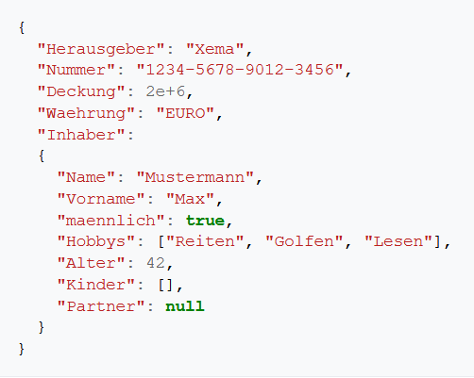
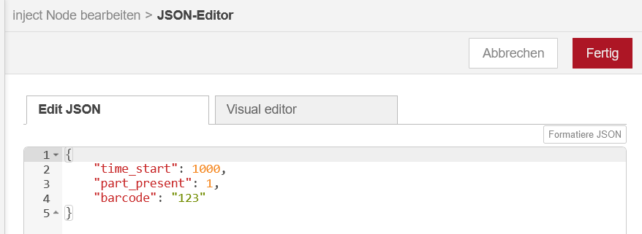
JSON
JavaScript Object Notation is a compact data interchange format with a syntax that can be easily understood by human users.
Native format to serialize JavaScript objects
Used for data exchange between applications
Independent of a programming language. There are libraries for probably every programming language
In Node-RED, JSON is used to construct messages

Slide 39
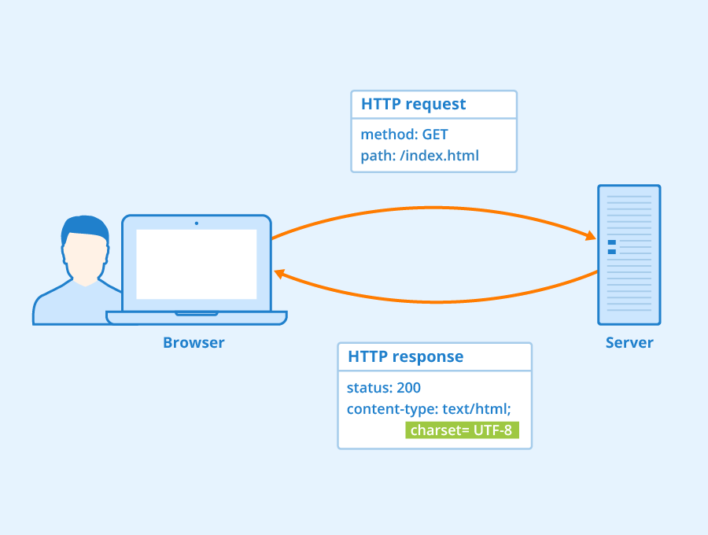
HTTP
Hypertext Transfer Protocol is a stateless application layer protocol to transfer data in a network
Typically used to load websites (= "Hypertext documents") of the WWW or to interact with web services
Data is exchanged through messages, which are sent in a request-response transaction
A client sends a request to a server using various HTTP methods to create, read, update or delete information
Server sends a response back to the client (successful / not successful)

Slide 40
<< Coffee Break >>

Slide 41
Session 2
Parts 3 and 4

Slide 42
Agenda
Introduction & Scenario Description
Implementation Part 1 (Basics + HTTP)
Ontologies, SPARQL & Capabilites
Implementation Part 2 (Products and Agent Registration)
Thoughts on Negotiations & Semantics for Agents
Implementation Part 3 (Message Processing)
Implementation Part 4 (Bid Selection)
Session 1
Coffee Break
Session 2

Slide 43
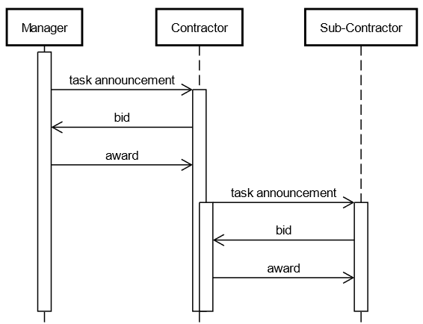
Negotiation – Protocol and Implementation
In small groups:
What is the goal & advantage of a negotiation at this point? What are disadvantages?
What influences are / aspects can be accounted for?
How does a simple negotiation i.e. auction look like?
Based on Smith, R. G., “The Contract Net Protocol: High-Level Communication and Control in a Distributed Problem Solver,” IEEE Trans. Comput., vol. C-29, no. 12, pp. 1104–1113, 1980.
Notes:
Network overload → DF, decomittments (Sandholm paper), degree of business of contractors (accept with time to do it)
Takes longer than fixed connections
Indecision problem (concurrent scheduling applications)
Dynamic states of resources are accounted for

Slide 44
Overview

Slide 45
Negotiation – Protocol and Implementation
In small groups:
What has to happen within the software at this point (to optimize the negotiation‘s outcome and minimize its duration)?
Notes:
Either wait for all answers (if possible) to have the best solution or continue after x ms to avoid a stalling application
Why reject proposal? Free up offering agents

Slide 46
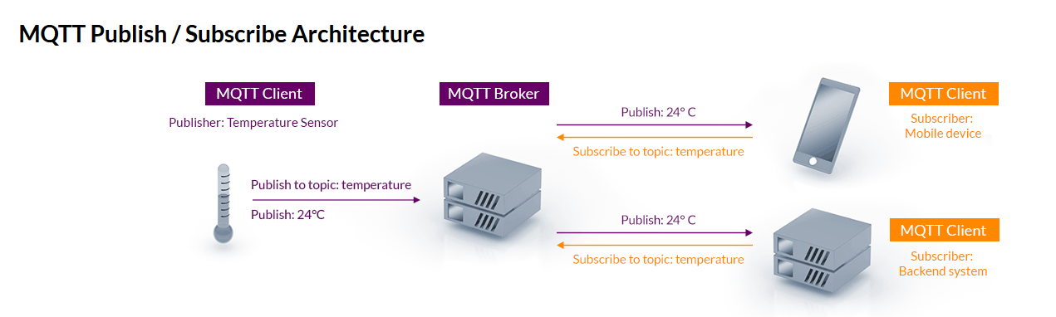
MQTT
What is MQTT?
„MQTT […] is a lightweight, publish-subscribe, machine to machine network protocol. It is designed for connections with remote locations that have devices with resource constraints or limited network bandwidth.” Wikipedia
Source: https://mqtt.org/

Slide 47
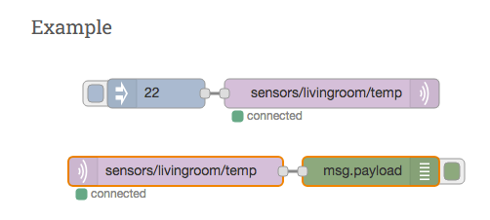
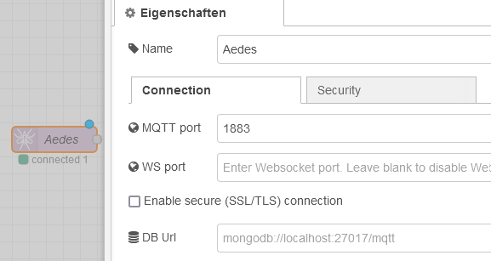
MQTT in Node-RED
Node-RED provides the in and out nodes
But this requires a separate MQTT server like Mosquitto
Other solution: Aedes (https://flows.nodered.org/node/node-red-contrib-mqtt-broker)
https://cookbook.nodered.org/mqtt/connect-to-broker

Slide 48
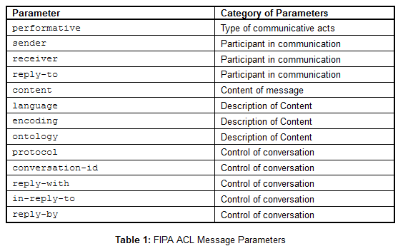
Structuring Messages
Long-standing guideline: FIPA ACL
Conversation ids
Performatives
Content language
However, it is a bit outdated and lacks support for, e.g. „event notification at the low control level, integration with legacy systems and a combination of services and agent-based systems”
Source: http://www.fipa.org/specs/fipa00061/SC00061G.html
I. Seixas and P. Leitão, “Standards Compliance in Industrial Agents Applications,” in IEEE IECON, Nov. 2013.
Notes:
We use JSON as content language here
Überleitung: Content slot can be structured according to one‘s needs

Slide 49
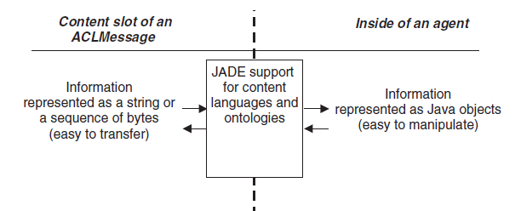
Ontologies for Multi-Agent Systems
Case 1: Message passing and interpreting
Case 2: Agent knowledge bases
JADE
Runtime Environment
Java
Queries with
SPARQL
Jena
SPARQL
Bellifemine, F. L., Caire, G., & Greenwood, D. (2007). Developing multi-agent systems with JADE. John Wiley & Sons.
Ontology imports in
RDF/XML format
Protégé
SHACL
Rules
Notes:
JAVA serialization is only for JAVA and not human readable
Query their product ontology for product requirements, query their resource model for answering CFPs / inquiries

Slide 50
Ontologies for Multi-Agent Systems
VDI3682 vocabulary
Ontologies are well suited to define a shared vocabulary by explicitly creating relations between different terms
Defining new relations → so-called "ontology alignment"
Define equivalent classes
Subclassing
Define new relations
Using rules that allow inferring new facts
"Everything that has a capability is an agent"
"Every process operator that manipulates X, Y and Z coordinate of an input is a handling operation"
VDI3682:State
Agent vocabulary
VDI3682:hasInput
VDI3682:hasOutput
Agent:Capability
owl:equivalentClass
VDI3682:ProcessOperator
agent:hasCapability
rdfs:subClassOf
agent:Agent
DIN8580 vocabulary
DIN8580:ManufacturingOperation
rdfs:subClassOf
DIN8580:Turning
DIN8580:Drilling
DIN8580:Milling

Slide 51

Negotiation – Protocol and Implementation
In small groups:
What should happen (internal logic) with the different performatives?
Implement different performative handling
15 Minutes (in groups)
Notes:
Conversation id to allocate the accept proposals correctly

Slide 52
Selecting a matching gripper
When is a gripper able to handle a workpiece?
If X, Y, Z of the workpiece are within the gripper's work area and workpiece length <= max. length
PREFIX agents: http://www.hsu-hh.de/aut/ontologies/agent-summer-school#
PREFIX VDI3682: http://www.hsu-ifa.de/ontologies/VDI3682#
PREFIX DINEN61360: http://www.hsu-ifa.de/ontologies/DINEN61360#
SELECT ?elem ?type ?expGoal ?expression WHERE {
agents:Gripper_A agents:hasCapability ?capability.
?capability VDI3682:hasInput ?elem.
?elem DINEN61360:has_Data_Element ?de.
?de DINEN61360:has_Type_Description ?type;
DINEN61360:has_Instance_Description ?inst.
?inst DINEN61360:Value ?val;
DINEN61360:Logic_Interpretation ?logInt;
DINEN61360:Expression_Goal ?expGoal.
BIND(CONCAT(STR(?expGoal), STR(?logInt), STR(?val)) AS ?expression)
}
Find types and instance descriptions of all input data elements
Find value, logic interpretation (e.g. "<=") and expression goal ("Requirement")
Create an expression by concatenating expression goal, logic interpretation and value.
Example: "Requirement <= 75"
This expression is used in Node-RED:
Replace "Requirement" with the current value
Evaluate the expression using "eval"

Slide 53
Negotiation – Protocol and Implementation
Implement selection process (cheapest offer)
10 Minutes (in groups)
Notes:
Conversation id to allocate the accept proposals correctly

Slide 54
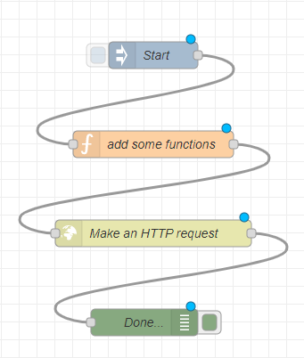
Conclusion
Basics of Node-RED (low-code and edge-capable)
MAS can be developed very quickly while being integrated with handy APIs etc.
HTTP & MQTT
Both are easily usable within Node-RED and both have their advantages / disadvantages
Basics of the Semantic Web
Short introduction into possible applications of ontologies
Code is available on Github (https://github.com/hsu-aut/ISSIA22-node-red-agents)
Feel free to use that as a playground /starting point for future applications

